Slide 1

MERN Setup
Quick Guide to Setup Your MERN Project
yourwebsite.com
→

Slide 2
Introduction
→
In this presentation, well walk through setting up your MERN development environment from scratch on Windows. Youll learn how to organize project folders, install Node.js and MongoDB, and troubleshoot common installation issues. Well also cover running the backend and frontend servers to get your project up and running smoothly.

Slide 3

MERN Setup Basics
↓

Slide 4
Windows Setup and Folder Structure
→
Start by creating a main project folder, for example, TeachMERN, on your drive. Open Command Prompt within this folder by typing cmd in File Explorers address bar. Use a single-line command to create backend and frontend subfolders, initialize backend with package.json, install dependencies, and prepare scripts to run both servers efficiently.

Slide 5
Node.js, npm, and MongoDB Installation Fixes
→
Sometimes npm scripts are blocked by PowerShell, or npm and Node.js commands fail due to missing folders or PATH misconfiguration. Fix these by adjusting execution policies, creating necessary folders, and adding Node.js paths to your system environment variables. Confirm installation success by running node -v and npm -v commands.

Slide 6

Running Backend and Frontend Servers
Run the backend server with npm run dev --prefix backend and the frontend React app with npm run dev --prefix frontend in separate Command Prompts. The backend typically runs on http://localhost:8000 and the frontend on http://localhost:5173. This setup supports live reloading to speed up development.
↓

Slide 7
→

Slide 8

Backend Development Essentials
↓

Slide 9
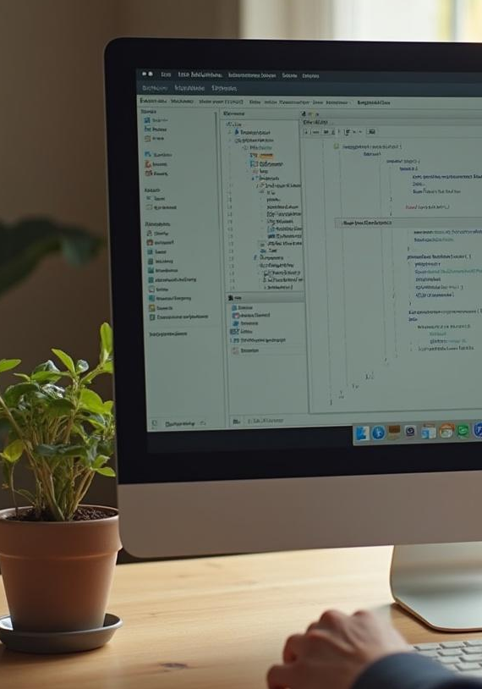
MongoDB Compass: Database Setup
MongoDB Compass lets you visually manage your database. Connect to the local server, create a database named learnMERN, and a students collection. Add student records manually through the UI in JSON format. This helps you understand document-based data storage compared to traditional relational databases.
↓

Slide 10
Creating APIs with Express and Mongoose
→
Build your backend APIs by defining a Student schema with Mongoose for enforced structure. Create routes to handle student records using CRUD operations: list, create, update, and delete. Test your API endpoints via curl or Postman and verify data integrity directly in MongoDB Compass.

Slide 11
Handling CRUD Operations
→
Implement CRUD operations using Express and Mongoose with clearly defined routes for reading, creating, updating, and deleting student data. Use Mongoose methods such as find(), create(), findByIdAndUpdate(), and findByIdAndDelete() for database interactions. Test endpoints with curl or Postman, and verify database updates visually with MongoDB Compass to ensure accuracy and consistency in your application.

Slide 12

Frontend Development with React
↓

Slide 13
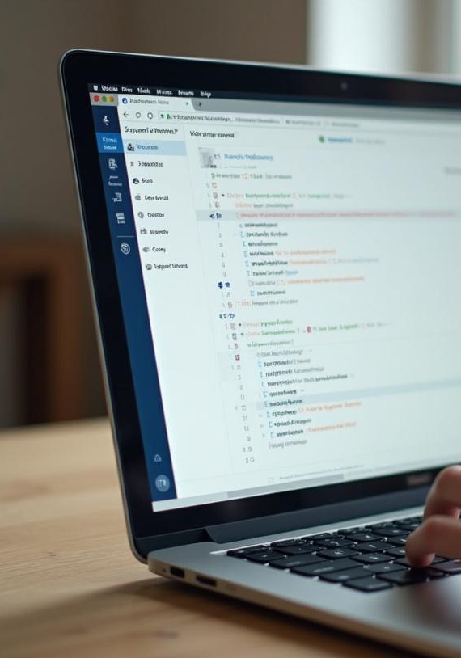
Fetching and Showing Student Data
Use React hooks like useState to store students and useEffect to fetch data on component mount. Fetch the list of students from the backend API and render them dynamically in a list. This initiates your React frontend connection to the backend and displays real-time student data on the UI with easy-to-understand state management techniques.
↓

Slide 14
Creating and Deleting Records
→
Add a controlled form to handle new student creation using useState for form inputs. Submitting the form triggers a POST request to the backend, followed by refreshing the student list. Implement delete functionality with buttons that send DELETE requests. After each mutation, reload the list to keep the UI synced with the backend.

Slide 15
Editing and Updating Records
→
Enable edit mode by storing the current records ID to toggle between create and update operations. Prefill the form fields with selected student data, modifying the submit button text accordingly. On form submission, send PUT requests to update existing records, then refresh the student list to show the latest data and maintain a seamless user experience.

Slide 16

MERN Project Tips and Best Practices
↓

Slide 17

Managing Environment Configuration
Organize environment variables in .env files using dotenv to keep sensitive configurations out of code. Ensure correct paths and ports for backend and frontend are defined consistently to avoid conflicts. Proper environment management facilitates smooth transitions between development, testing, and production setups.
↓

Slide 18
Troubleshooting Common Errors
→
Address typical issues like script execution policies, missing npm folders, or misconfigured PATH variables on Windows. Use step-by-step fixes such as adjusting PowerShell policies and editing system environment variables. Verifying with commands like npm -v and node -v ensures your development environment is correctly set up for MERN stack work.

Slide 19
Streamlining Development Workflow
→
Utilize tools like nodemon for automatic backend server restarts and Vite for fast React frontend builds. Run backend and frontend servers concurrently in separate command prompts for efficient development. Constantly reload data after CRUD operations to keep UI and database in sync, improving productivity and minimizing errors.

Slide 20

Conclusions
Building a MERN stack app involves setting up a robust backend with Express and Mongoose, managing data using MongoDB, and crafting an interactive React frontend. Understanding environment setup, troubleshooting, and smooth workflows sets the foundation for productive development. Mastering CRUD operations and syncing frontend-backend interactions completes the learning journey toward full-stack JavaScript proficiency.
↓

Slide 21

Thanks!
Do you have any questions?
youremail@freepik.com
+34 654 321 432
yourwebsite.com
↓
CREDITS: This presentation template was created by Slidesgo, and includes icons, infographics & images by Freepik
Please keep this slide for attribution

